Slide 1
Teaching Pronunciation
A case for the
lenient allophone
of the voiced stop /b/
Manuela González-Bueno CASPSLaP
University of Kansas Georgetown University
mgbueno@ku.edu March 14-16, 2014
Notes:
This target segment was selected because it presents more challenges in terms of its teaching than those segments which can be taught using minimal pairs, such as the Spanish trill versus the tap (cero/cerro, coro/corro, pero/perro, caro/carro… etc.) or the high, front vowel [i] versus the mid high vowel [e] (si/se, di/de, silo/celo, sida/seda… etc.)

Slide 2
Presentation:
En la aduana:
Pre-listening questions (warm-up):
¿Has viajado alguna vez al extranjero?
¿Qué tipo de documentos necesitas para pasar la aduana?
¿Has tenido algún problema en la aduana alguna vez?

Slide 3
Presentation (Cont.):
Listen to the dialogue between a traveler and a custom officer and answer the comprehension questions provided.
Which document does the officer ask the traveler to present?
Does the traveler have the required document?
Can the traveler go through customs without that document?
Where does the office tell the traveler to go?
Script

Slide 4
Attention:
Listen to it again and, this time, pay attention to how the word visado (“visa”) is not always pronounced the same way.
Hint: Sometimes it’s pronounced as [bisado] and some other times as [ isado].

Slide 5
Attention:
Script:
Policía: Su [ ]isado, por favor.
Viajero: ¿[ ]isado? ¿Qué [ ] isado?
Policía: Usted necesita un [ ]isado para entrar en el país.
Viajero: ¿Un [ ]isado? Pues yo no tengo [ ]isado. ¡Nadie me dijo que necesitaba un [ ]isado!
Policía: Lo siento, pero sin [ ]isado no puede entrar. Por favor, acompáñeme a la oficina.

Slide 6
Attention:
Script:
Policía: Su isado, por favor.
Viajero: ¿Bisado? ¿Qué isado?
Policía: Usted necesita un bisado para entrar en el país.
Viajero: ¿Un bisado? Pues yo no tengo isado. ¡Nadie me dijo que necesitaba un bisado!
Policía: Lo siento, pero sin bisado no puede entrar. Por favor, acompáñeme a la oficina.

Slide 7
Spectrograms
[ ] from “su visado”
[b] from “con visado”
u i
m b i
Lenition
Occlusion
Notes:
At this time, and depending on the proficiency and grade level of the learners, it might be pertinent to go deeper in the analysis of the two target allophones, the stop and the fricative, by showing visual representations of their actual oral productions, i.e., their spectrograms.

Slide 8
Co-Construction:
Can you come up with the rule for the distribution of [b] and [ ] by looking at the phonetic context in which the phoneme represented by the “v” (that is, /b/) appears?
Context | [b] | [ ]
Su visado
¿Qué visado?
¿visado?
un visado
tengo visado
sin visado

Slide 9
Co-Construction:
Can you come up with the rule for the distribution of [b] and [ ] by looking at the phonetic context in which the phoneme represented by the “v” (that is, /b/) appears?
Context | [b] | [ ]
Su visado |  | x
¿Qué visado? |  | x
¿visado? | x
un visado | x
tengo visado |  | x
sin visado | x

Slide 10
Rule
The stop allophone [b] is pronounced
in absolute initial position (“¿Visado?”)
and when preceded by a nasal segment (“Un visado”).
The spirant [β] occurs elsewhere.

Slide 11
Input drill 1: Discrimination
Listen to the following phrases and determine whether the phoneme /b/ in the word “visado” is pronounced in the same or in a different way :
Script | Same | Different
..
2.
3.
4.

Slide 12
Input drill 1: Discrimination
Listen to the following phrases and determine whether the word “visado” is pronounced in the same or a different way :
Script | Same | Different
Mi visado/Su visado | x
2. El visado/Un visado |  | x
3. Sin visado/Con visado | x
4. Su visado/visado |  | x

Slide 13
Input drill 2: Identification
Listen to the following phrases and determine whether the phoneme /b/ is pronounced as [b] or as [ ]:
Script | [b] | [ ]
1.
2.
3.
4.
5.

Slide 14
Input drill 2: Identification
Listen to the following phrases and determine whether the phoneme /b/ is pronounced as [b] or as [ ]:
Script | [b] | [ ]
1. Visado | x
2. El visado |  | x
3. Sin visado | x
4. Mi visado |  | x
5. Un visado | x

Slide 15
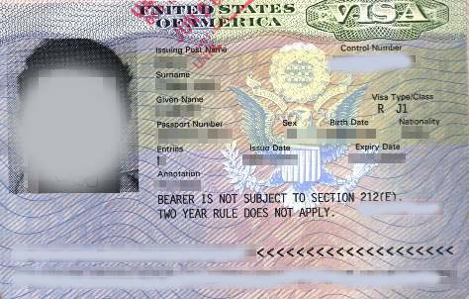
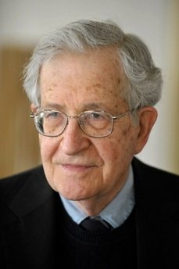
Output drill:
You are going to be shown two different images in random order, one of an undetermined “visado” (“un visado”) and another of your teacher’s “visado” (“su/tu visado”). Identify which one it is every time you see the image, concentrating in the correct pronunciation of the sound representated by “v” (that is, /b/) as either [b] or [ ]:
Un visado Su visado

Slide 16
Output drill

Slide 17
Other output
With a partner, role-play the dialogue “En la aduana,” this time focusing on all the instances of the phoneme /b/ (there are only two more: in the words “necesitaba” and “favor”) and pronouncing the correct allophones [b] and [ ]. Alternatively, come up with a different version of the dialogue, always including the word “visado.” Take turns in being the customs officer and the traveler.
Notes:
The word used in this lesson, “visado,” and the one suggested later for Extrapolation to Other Contexts (slide #19,) “verduras,” both happen to be spelled with a “v,” which should not distract of, on the contrary, should reinforce, the fact that “v” is just a grapheme and that by no means it represents the phoneme /v/, but /b/.

Slide 18
Extension:
With different partners, pretend to be alternatively the traveler and the customs officer and relate to a friend what happened to you at the airport.

Slide 19
Extrapolation to other contexts:
Now, create a dialogue with a partner in which you discuss whether you should serve some vegetables (“verduras”) at the party this weekend.
Notes:
The word used in this lesson, “visado,” and the one suggested here, “verduras,” both happen to be spelled with a “v,” which should not distract of, on the contrary, should reinforce, the fact that “v” is just a grapheme and that by no means it represents the phoneme /v/, but /b/.

Slide 20
Presentation:
(Script:)
Policía: Su visado, por favor.
Viajero: ¿Visado? ¿Qué visado?
Policía: Usted necesita un visado para entrar en el país.
Viajero: ¿Un visado? Pues yo no tengo visado. ¡Nadie me dijo que necesitaba un visado!
Policía: Lo siento, pero sin visado no puede entrar. Por favor, acompáñeme a la oficina.

