Slide 1
Training Spanish vowels
Carmen Lie-Lahuerta
Research Institute ACLC
University of Amsterdam
lie@uva.nl

Slide 3
Problem
Challenging task for L2 learner acquiring new vowel sounds: requires time and individual attention from teacher.
Native like production of L2 sounds only when learner becomes proficient in perceiving the target sounds → L1 vowelsystem is persistent.
Articulatory properties difficult to describe and
Vowel articulation is difficult to observe without special instrumentation.
Critical period.

Slide 4
Infants lose the ability to discriminate nonnative contrasts
(Kuhl, 1991)

Slide 5
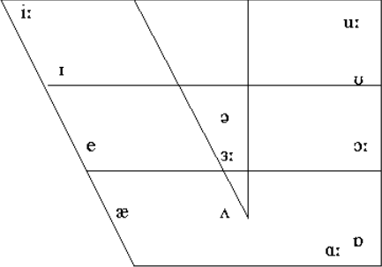
English vowel system 12 monophthongs

Slide 6
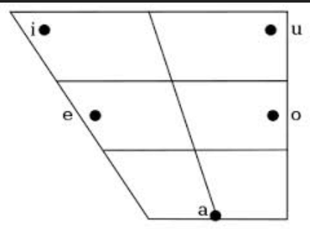
Spanish vowel system 5 monophthongs

Slide 7
Predictions: Multiple Category Assimilation (Morrison 2006)
Notes:
the learner is being faced with a language whose phonemic categories constitute a subset of the L1 ones. In the initial state of the learning process,the learner will perceive more categories than the L2 listener

Slide 8
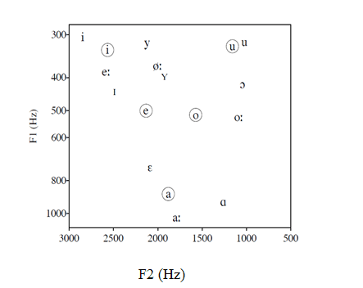
Production

Slide 9
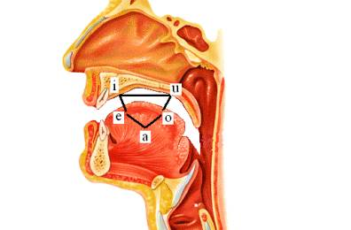
Solution
The Fix Your Vowels program: hear and see the vowels.
Shows how and where vowels
are formed in the mouth.
Like playing darts with your voice.

Slide 10
The architecture of Fix your vowels
Map of F1 en F2 frecuencies (F1 - F2 )→ pinpoints your vowel on the triangle.
Formant values differ per individual → calibration procedure = vowel normalisation (Lobanov 1971)
Feedback: higher/lower (F1) and forward/backness (F2)
200 Spanish words: different male and female speakers
Student’s voice is recorded as wav files.
Notes:
The main purpose of the vowel similarity metric is to determine if a given student’s vowel token falls within a vowel space derived from a target set of vowels produced by native speakers.
Unfortunately, formant values measured for the same vowel differ when different individuals with distinct vocal tract shapes and cavity sizes produce the tokens. Thus, in the present
study, we have opted for a straightforward vowel normalisation, also called calibration procedure, first used by Lobanov (1971), which is simply a z-normalisation of the F1 and F2 frequencies
over the vowel set produced by each individual speaker. In the znormalisation, the F1 and F2 are transformed to z-scores by subtracting the individual speaker’s mean F1 and F2 values from the
raw formant values and dividing the difference by the speaker’s standard deviation. We applied Hertz values to the calibration procedure.

Slide 11
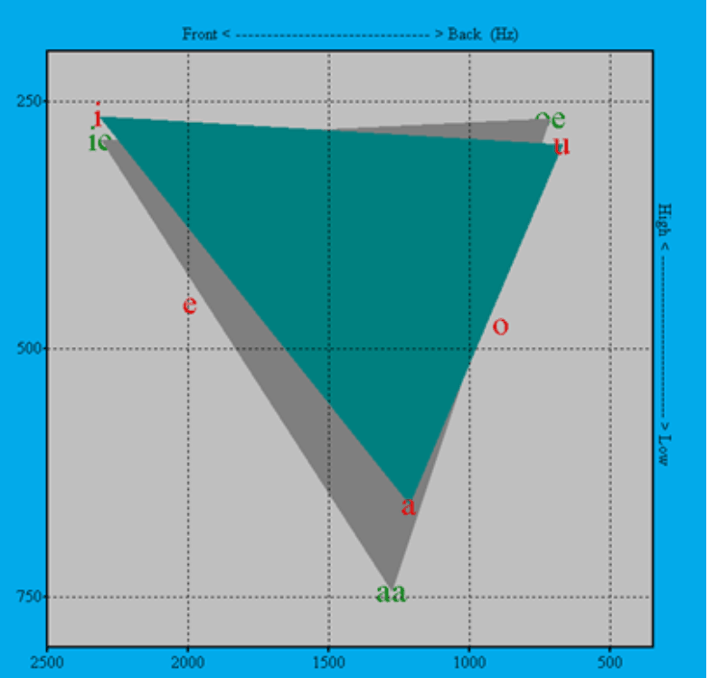
Program Fix your vowels
F2 (Hz)
F1 (Hz)

Slide 12
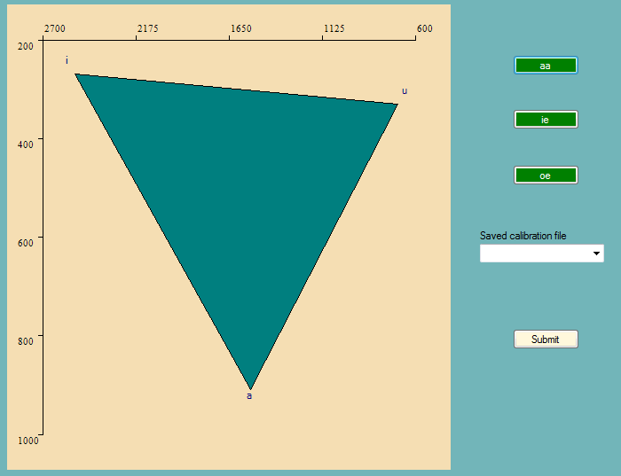
Calibration

Slide 13
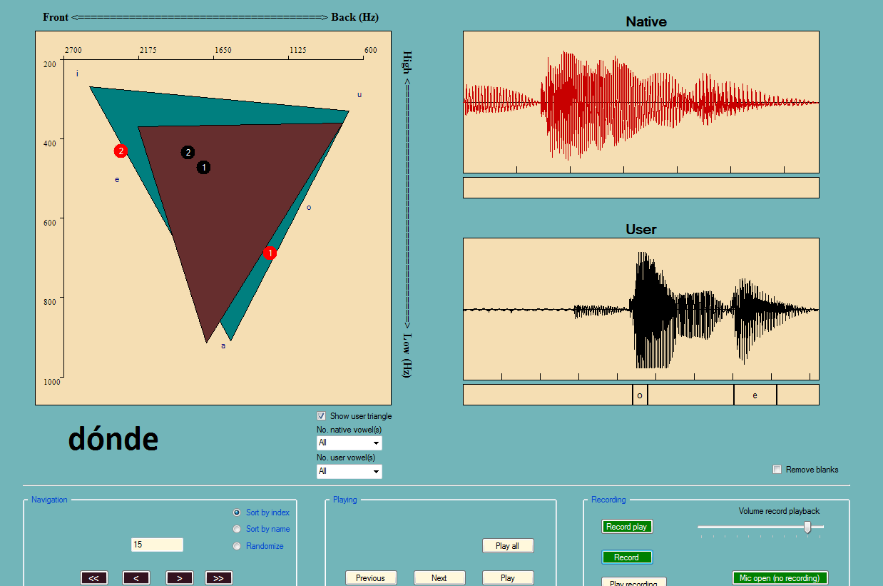
Pronouncing Dónde
22
1
2
Notes:
The vowel triangle is placed above a small prompt window and four user buttons. The main display shows 1) the vowel triangle (to provide a
reference for the articulatory position of vowel targets), 2) the vowel, exposed in the learner’s triangle in yellow, 3) the vowel, exposed
in the native speaker’s triangle in red, and 4) a real-time feedback indication, produced two seconds after pronouncing the word and aimed at improving the position of the vowel.
the vowel, exposed in the learner’s triangle in black,the vowel, exposed in the native speaker’s triangle in red, a real-time feedback indication, produced two seconds after pronouncing the word
Aim at the correct vowel position: by reducing or increasing the first formant (vowel height), the second formant (vowel backness), or both.

Slide 14
Fix Your Vowels 1.7 . rar file
http://uvafon.hum.uva.nl/dirk/ed/

Slide 15
Steps to start the program:
Click on the directory Fix Your Vowels 1.7 dec. 2013.
Open Fix Your Vowels.exe
Insert surname, initials, student number (8 digits) and gender.
Start calibration for your personal vowel triangle: click on the buttons and pronounce an /a:/, /i:/ and /u:/.
First practice with the CVC and CVCV nonsense words, after this you can try the real words. You will find the exercises under the button EXPERIMENTS (left at the top of the page)

Slide 16
Thank you.

